Slide 1
QT SDK Introduction

Slide 2
Overview
Features
Applink 2.0 protocols
Video streaming
Touch events
TTS (Windows platform)
No VR support

Slide 3
Overview
Platforms
Windows
WinCE
Ubuntu
Android
Could easily support QNX, iOS, OSX, etc.

Slide 4
Overview
Dependency
QT: For UI development.
ffmpeg: For video streaming.
pthread: For network thread.

Slide 5
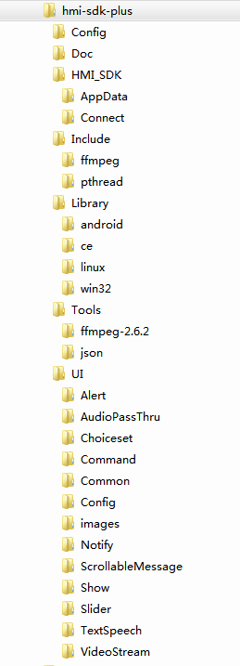
File Structure
Config: The vehicle data repository
HMI_SDK
AppData: To store the application data
Connect: To connect to the SDL
Library: The running libraries.
Tools: The source-code of ffmpeg and json.
UI: The UI code.

Slide 6
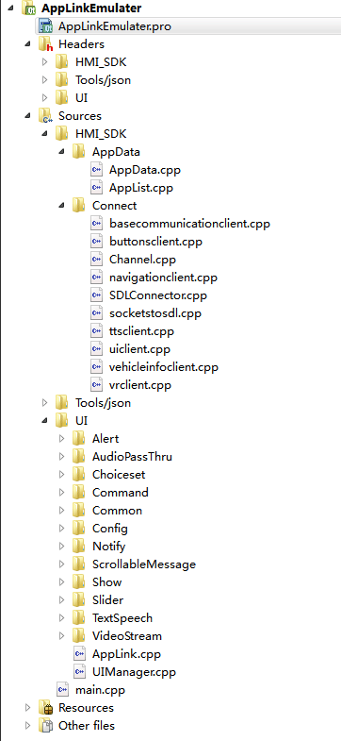
Project Structure
SDLConnector.cpp
To connect to the SDL
AppList.cpp
To store the request from SDL.
The control layer.
UIManager.cpp
To control the UI

Slide 7

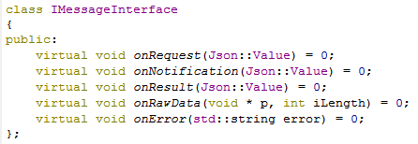
Network Layer to SDL
To connect to SDL (Connect to 127.0.0.1:12346):
To receive message from SDL:

Slide 8
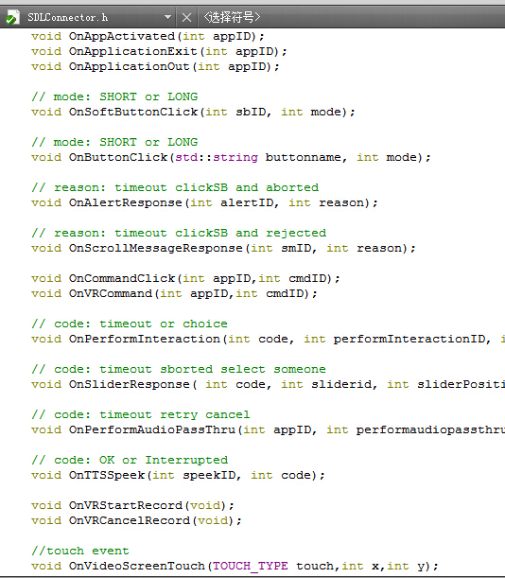
Network Layer to SDL
To send message to SDL:

Slide 9
Control Layer
To receive message from the SDLConnector
To store the requests for the UI classes.
To send message to the SDLConnector.

Slide 10
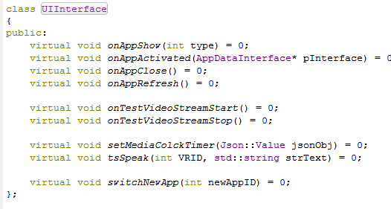
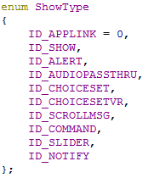
The UI Layer
onAppShow notifies which UI should be shown.
To store the requests for the UI classes.
To send message to the SDLConnector.

Slide 11
Video Streaming
Use ffmpeg to play the video on Win32 and Ubuntu platforms.
In smartDeviceLink.ini:
Set VideoStreamConsumer = socket
Set VideoStreamingPort = 5050

Slide 12
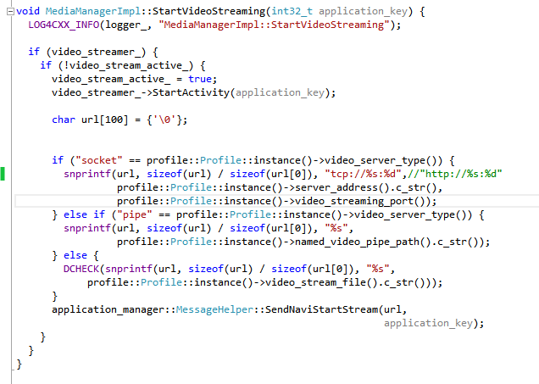
Video Streaming
Modify the SDL Like below

Slide 13

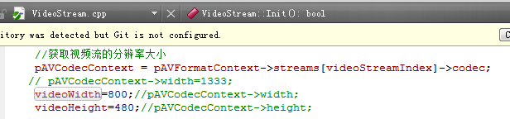
Video Streaming
The AppData.cpp receives the message:
The VideoStream.cpp uses the ffmpeg to play the video:

Slide 14
To Compile for WinCE
Install QT 4.8 in Windows.
Install WinCE 7 SDK.
Use Astrid compiler and the qmake of WinCE 7 SDK in QT.
Add WinCE Kits.

Slide 15
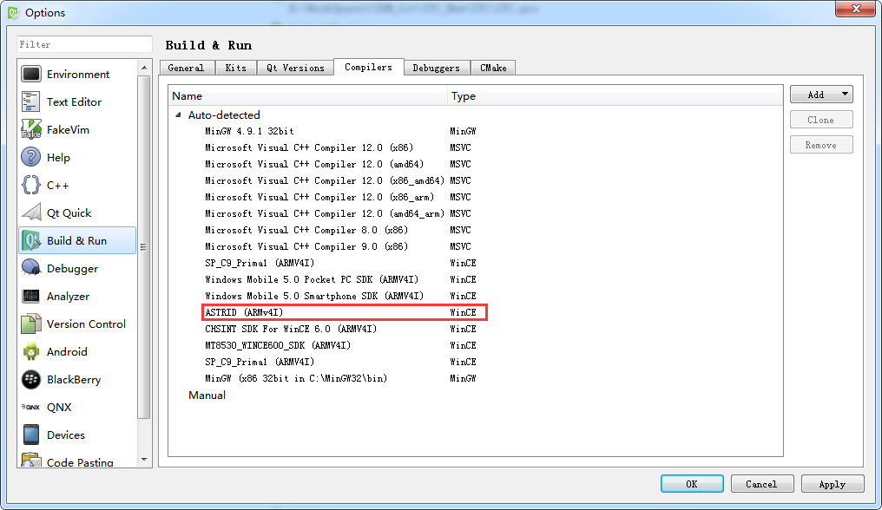
To Compile for WinCE

Slide 16
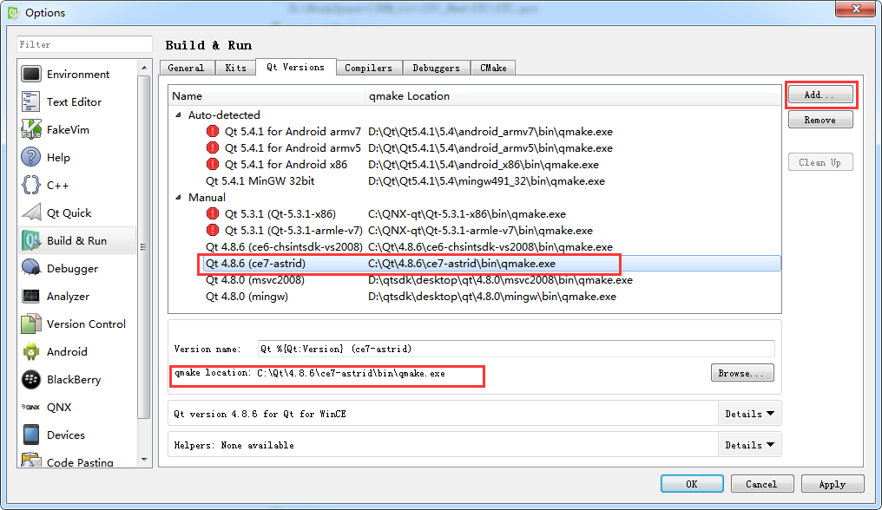
To Compile for WinCE

Slide 17
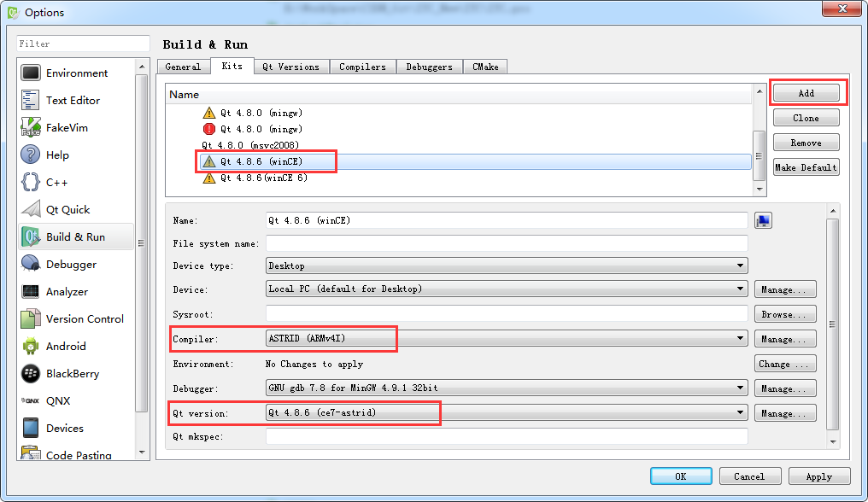
To Compile for WinCE

Slide 18
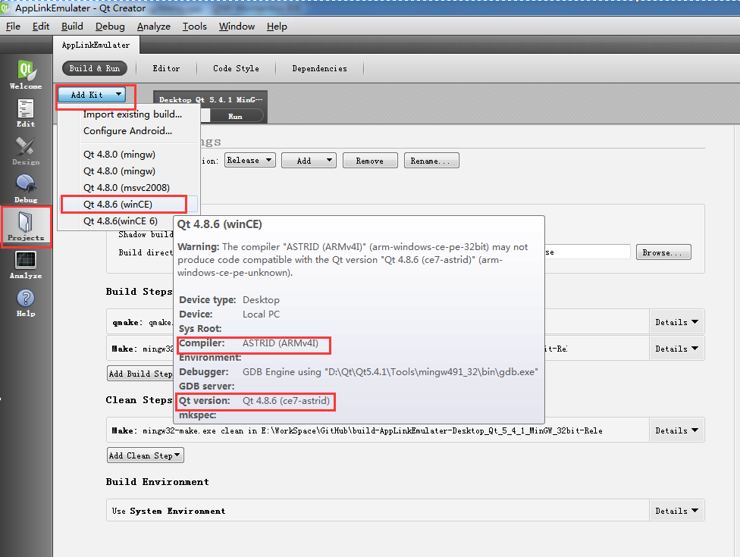
To Compile for WinCE

Slide 19
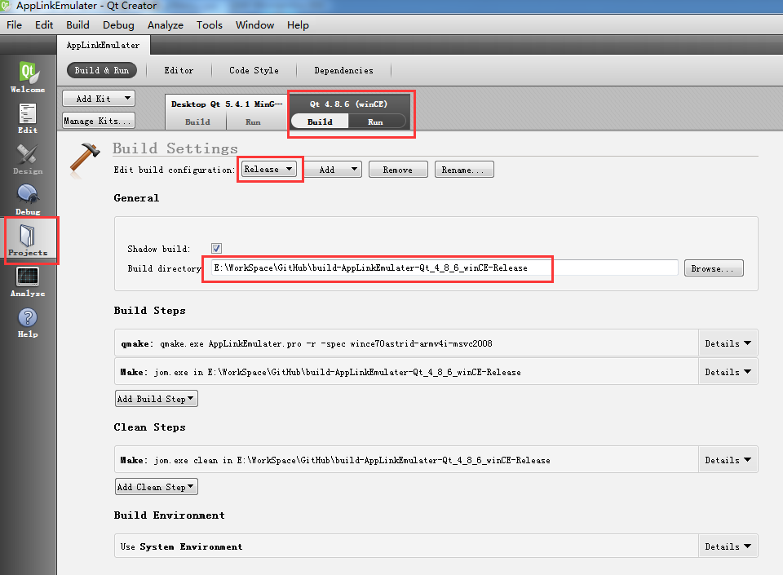
To Compile for WinCE

Slide 20
To Compile for WinCE
Compile the project.
Copy the Config folder to the output directory.
Copy the DLL libraries in Library/ce folder to the output directory.

Slide 21
To compile for Ubuntu
Install QT 4.8 or later
Intall gcc.
Setup the C++ compiler , qmake, Kits in QT.
Compile the project.
Copy the Config folder to the output directory.
Copy the libraries in Library/linux/ffmpeg folder to the output directory.

Slide 22
To compile for Windows
Install QT 4.8 or later
Install Visual Studio C++ or mingw.
Setup the C++ compiler , qmake, Kits in QT.
Open AppLinkEmulater.pro and compile the project.
Copy the Config folder to the output directory.
Copy the DLL libraries in Library/win32 folder to the output directory.

Slide 23
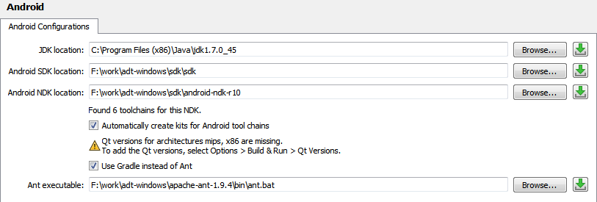
To compile for Android
Install QT 5.5 for Android in Windows.
Install Android JDK, SDK, NDK, ANT. Set the PATH.
Setup the C++ compiler(NDK), qmake(Qt/5.5.1/android_armv7 /bin), Kits in QT.
Tools→ Options→Android

Slide 24
To compile for Android
Compile the project.
The output is just a .so library and needs more works to packet it to a APK.

Slide 25
The end
Thanks.

